Slide 1
Understanding Transformer Architecture

Slide 2
Recap
H₀
Encoder RNN
x₁
Komm
ENCODER

Slide 3
Recap
H₀
Encoder RNN
H₁
Encoder RNN
x₁
x₂
Komm
bitte
ENCODER

Slide 4
Recap
H₀
Encoder RNN
H₁
Encoder RNN
H₂
Encoder RNN
x₁
x₂
x₃
Komm
bitte
her
ENCODER

Slide 5
Recap
C
Decoder RNN
H₀
Encoder RNN
H₁
Encoder RNN
H₂
Encoder RNN
<SOS>
x₁
x₂
x₃
Komm
bitte
her
ENCODER

Slide 6
Recap
DECODER
Please
C
Decoder RNN
H₀
Encoder RNN
H₁
Encoder RNN
H₂
Encoder RNN
<SOS>
x₁
x₂
x₃
Komm
bitte
her
ENCODER

Slide 7
Recap
DECODER
Please
come
here
C
Decoder RNN
Decoder
Decoder
RNN
RNN
H₀
Encoder RNN
H₁
Encoder RNN
H₂
Encoder RNN
<SOS>
x₁
x₂
x₃
Komm
bitte
her
ENCODER

Slide 8
Transformer Architecture
Please
come
here
Encoder Block
Decoder Block
x₁
x₂
x₃
Komm
bitte
her

Slide 9
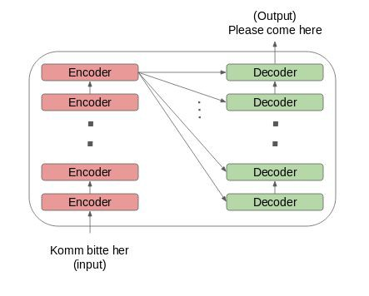
Transformer Architecture

Slide 10
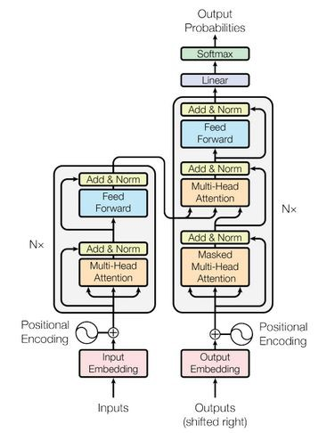
Transformer Architecture

Slide 11
Encoder-Decoder in Transformer
NN
NN
NN
Encoder 2
Self-Attention
NN
NN
NN
Encoder 1
Self-Attention
Komm
bitte
her

Slide 12
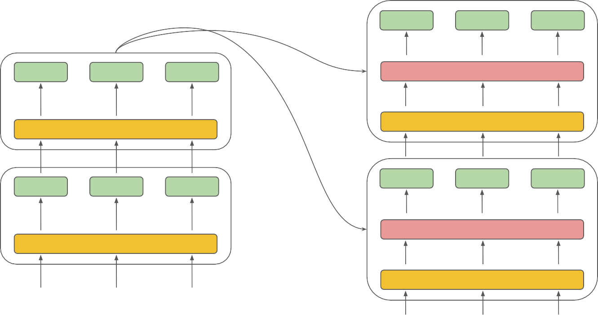
Encoder-Decoder in Transformer
NN
NN
NN
NN
NN
NN
Encoder-Decoder Attention
Decoder 2
Encoder 2
Self-Attention
Self-Attention
NN
NN
NN
NN
NN
NN
Encoder 1
Encoder-Decoder Attention
Decoder 1
Self-Attention
Self-Attention
Komm
bitte
her
Please
come
here

Slide 13
Positional Embeddings in Transformer
NN
NN
NN
NN
NN
NN
Encoder-Decoder Attention
Decoder
Encoder
Self-Attention
Self-Attention
PE + WE
PE + WE
PE + WE
PE + WE
PE + WE
PE + WE
Komm
bitte
her
Please
come
here
PE - Positional Embedding WE - Word Embedding

Slide 14
Positional Embeddings in Transformer
p1
p2
p3
p4
Positional embeddings (PE) encode the order of tokens into ﬁxed size vectors
Positional embeddings

Slide 15
Positional Embeddings in Transformer
p1
p2
p3
p4
Positional embeddings (PE) encode the order of tokens into ﬁxed size vectors
Positional embeddings
Combined with word embeddings and passed to encoder and decoder layers
Positional embeddings
+
Word Embeddings

Slide 16
Positional Embeddings in Transformer
p1
p2
p3
p4
Positional embeddings (PE) encode the order of tokens into ﬁxed size vectors
Positional embeddings
Combined with word embeddings and passed to encoder and decoder layers
Positional embeddings
+
Word Embeddings
PE are generated by two functions
PE(p, 2i + 1) = cos(p/10000^{2i / emb_dim})
PE(p, 2i ) = sin(p/10000^{2i / emb_dim})

Slide 17
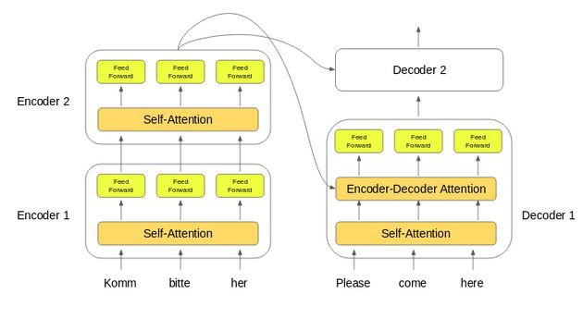
Encoder-Decoder in Transformer

Slide 18
Encoder-Decoder in Transformer
NN
NN
NN
NN
NN
NN
Encoder-Decoder Attention
Decoder 2
Encoder 2
Self-Attention
Self-Attention
NN
NN
NN
NN
NN
NN
Encoder 1
Encoder-Decoder Attention
Decoder 1
Self-Attention
Self-Attention
Komm
bitte
her
Please
come
here

Slide 19
Intuition behind Self Attention
“The kids were scared of the lions, so they left right away.”

Slide 20
Intuition behind Self Attention
“The kids were scared of the lions, so they left right away.”
?
?

Slide 21
Intuition behind Self Attention
“The kids were scared of the lions, so they left right away.”

Slide 22
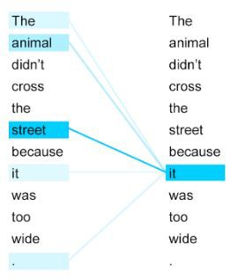
Intuition behind Self Attention

Slide 23
Encoder Layer in Transformer
Feed Forward NN
z₁
z₂
z₃
Self-Attention
x₁+p₁
x₂+p₂
x₃+p₃
Komm
bitte
her

Slide 24
Encoder Layer in Transformer
^{f}21
^{f}22
^{f}23
Encoder 2
^{f}11
^{f}12
^{f}13
Encoder 1
x₁+p₁
x₂+p₂
x₃+p₃
Komm
bitte
her

Slide 25
Decoder Layer in Transformer
Decoder
y₁+p₁
y₂+p₂
y₃+p₃
<start>
Komm
bitte

Slide 26
Decoder Layer in Transformer
Feed Forward NN
From Encoder
Enc-Dec Attention
Self-Attention
y₁+p₁
y₂+p₂
y₃+p₃
<start>
Komm
bitte

Slide 27
Thank You

